Slide 1
PERSONAL SPACE IN DIFFERENT CULTURES
Made by Vinetskaya Polina and Osipova Anastasiia

Slide 2
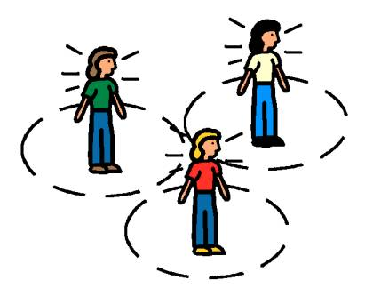
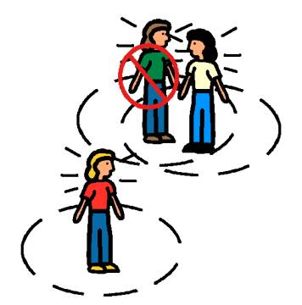
Introduction

Slide 3
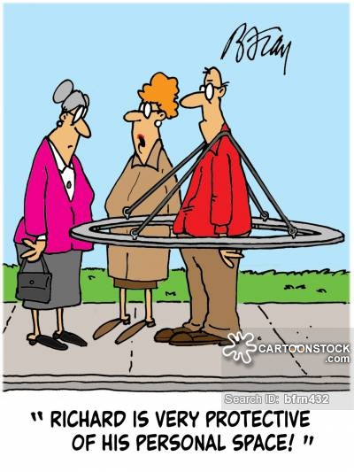
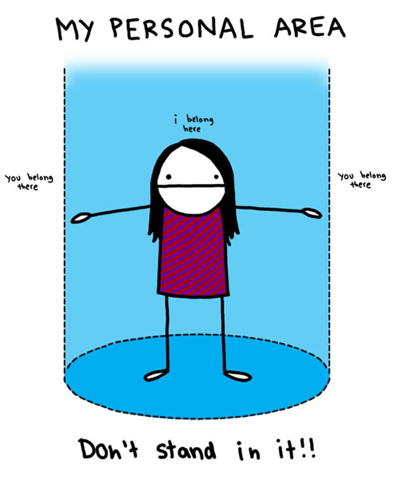
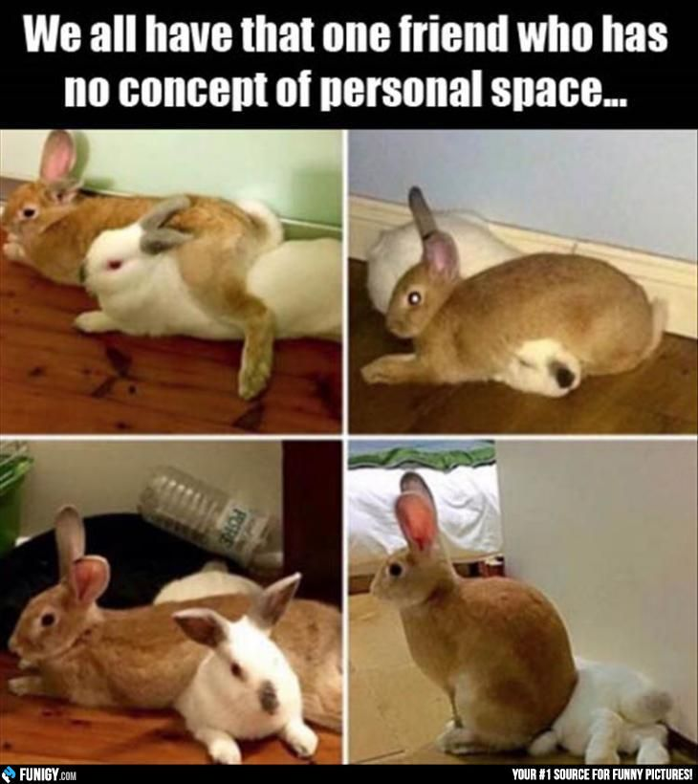
Feeling of the personal space

Slide 4
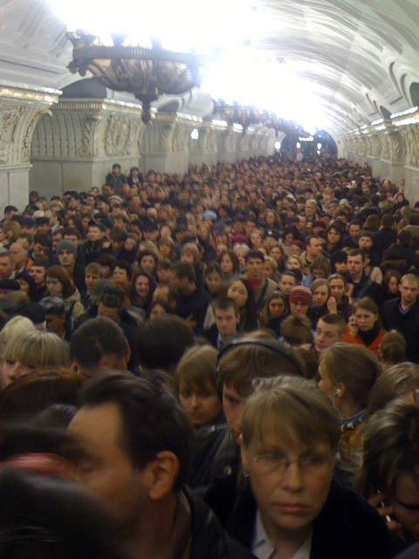
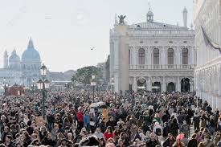
Space signals in different cultures

Slide 5
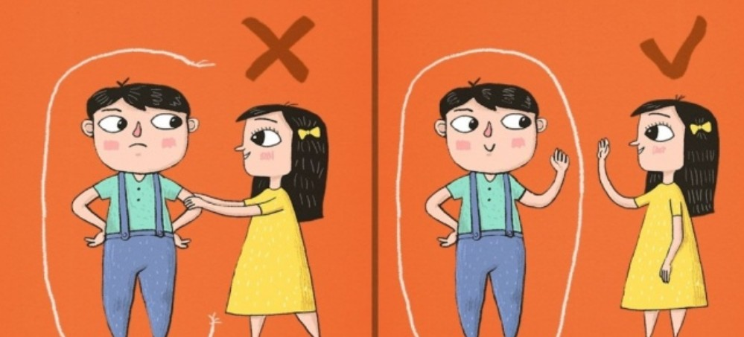
Dynamics of the motions

Slide 6

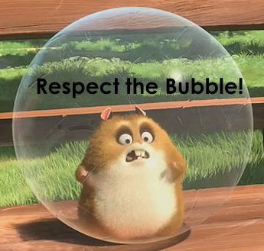
Germany

Slide 7

England

Slide 8



Slide 9

France

Slide 10

USA

Slide 11

Russia

Slide 12
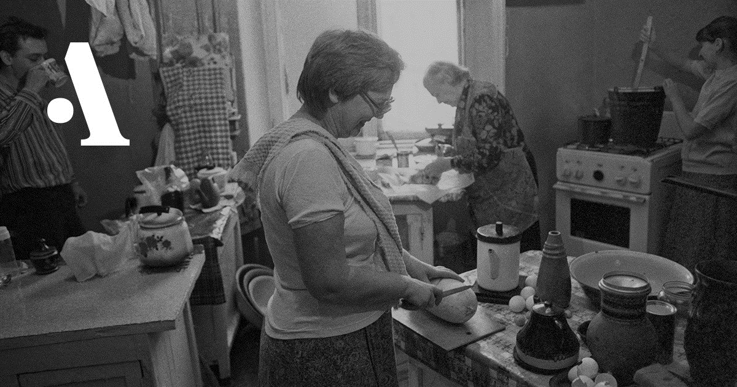

Slide 13
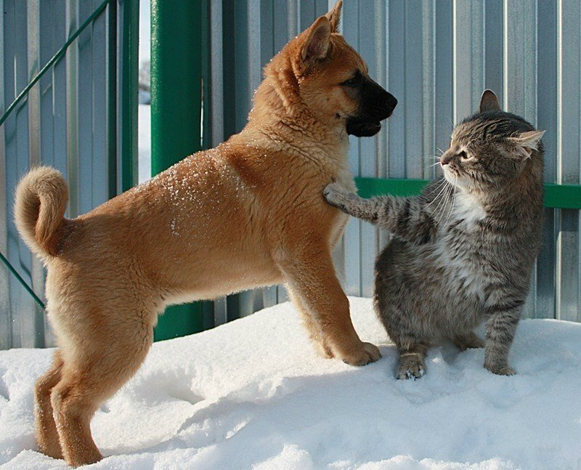
Conclusion

